Slide 1
Protection and Security in Operating Systems
Protection and Security
Notes:
Assumptions:
Graduate level
Operating Systems
Making Choices about operation systems
Why a micro-century? …just about enough time for one concept

Slide 2
Concepts
Protection:
    Mechanisms and policy to keep programs and users from accessing or changing stuff they should not do
    Internal to OS
    Chapter 14 in Silbershatz
Security:
    Issues external to OS
    Authentication of user, validation of messages, malicious or accidental introduction of flaws, etc.
    Chapter 15 of Silbershatz
Protection and Security

Slide 3
Outline
Part 1
    The first computer virus
    Protection mechanisms
Part 2
    Security issues
    Some cryptographic themes
Protection and Security

Slide 4
The First Computer Virus
Reading assignment:–
  Ken Thompson, “Reflections on Trusting Trust,” Communications of ACM, vol.27, #8, August 1984, pp. 761-763 (pdf)
Three steps
  Program that prints a copy of itself
  Training a compiler to understand a constant
  Embedding a Trojan Horse without a trace
Protection and Security

Slide 5
Step 1 – Program to print copy of itself
How do we do this?
First, store character array representing text of program
Body of program
    Print declaration of character array
    Loop through array, printing each character
    Print entry array as a string
Result: general method for program to reproduce itself to any destination!
Protection and Security

Slide 6
Step 2 – Teaching constant values to compiler
/* reading string constants */
if (s[i++] == '\\')
if (s[i] == 'n') insert ('\n');
elseif (s[i] == 'v') insert ('\v');
elseif …
Question: How does compiler know what integer values to insert for '\n‘, '\v‘, etc.?
Protection and Security

Slide 7
Step 2 (continued)
Answer: In the first compiler for this machine type, insert the actual character code
    i.e., 11 (decimal) for ‘\v’, etc.
/* reading string constants */
if (s[i++] == '\\')
if (s[i] == 'n') insert ('\n');
elseif (s[i] == 'v') insert (11);
elseif …
Next: Use the first compiler to compile itself!
Protection and Security

Slide 8
Step 2 (continued)
Result: a compiler that “knows” how to interpret the sequence “\v”
    And all compilers derived from this one, forever after!
Finally: replace the value “11” in the source code of the compiler with ‘\v’ and compile itself again
Note: no trace of values of special characters in …
  The C Programming Language book
  source code of C compiler
I.e., special character values are self-reproducing
Protection and Security

Slide 9
Step 3 – Inserting a Trojan Horse
In compiler source, add the text
    if (match(sourceString, pattern)
    insert the Trojan Horse code
    where “pattern” is the login code (for example)
In compiler source, add additional text
    if (match(sourceString, pattern2)
    insert the self-reproducing code
    where “pattern2” is a part of the compiler itself
Use this compiler to recompile itself, then remove source
Protection and Security

Slide 10
Step 3 – Concluded
Result: an infected compiler that will
  Insert a Trojan Horse in the login code of any Unix system
  Propagate itself to all future compilers
  Leave no trace of Trojan Horse in its source code
Like a biological virus:
  A small bundle of code that uses the compiler’s own reproductive mechanism to propagate itself
Protection and Security

Slide 11
Questions?
Protection and Security

Slide 12
Goals of Protection
Operating system consists of a collection of objects (hardware or software)
Each object has a unique name and can be accessed through a well-defined set of operations.
Protection problem – to ensure that each object is accessed correctly and only by those processes that are allowed to do so.
Protection and Security

Slide 13
Guiding Principles of Protection
Principle of least privilege
  Programs, users and systems should be given just enough privileges to perform their tasks
Separate policy from mechanism
  Mechanism: the stuff built into the OS to make protection work
  Policy: the data that says who can do what to whom
Protection and Security

Slide 14
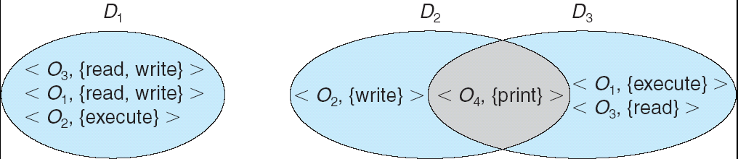
Domain Structure
Access-right = <object-name, rights-set>
where rights-set is a subset of all valid operations that can be performed on the object.
Domain = set of access-rights
Protection and Security

Slide 15
Conceptual Representation – Access Matrix
View protection as a matrix (access matrix)
Rows represent domains
Columns represent objects
Access(i, j) is set of operations that process executing in Domain_{i} can invoke on Object_{j}
Protection and Security

Slide 16
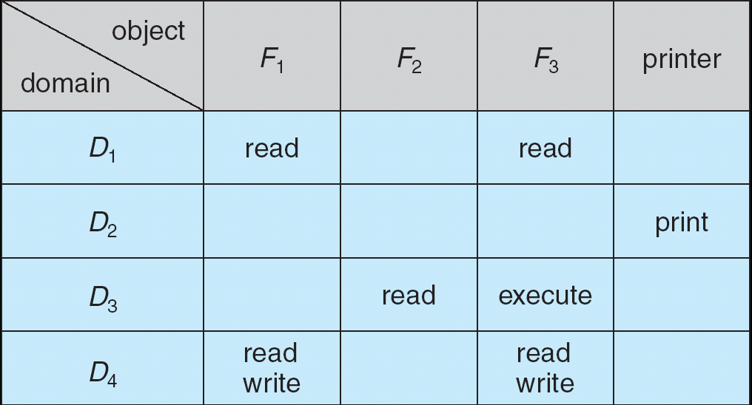
Textbook Access Matrix
Columns are access control lists (ACLs)
    Associated with each object
Rows are capabilities
    Associated with each user, group, or domain
Protection and Security

Slide 17
Unix & Linux
System comprises many domains:–
  Each user
  Each group
  Kernel/System
(Windows has even more domains than this!)
Protection and Security

Slide 18
Unix/Linux Matrix
 | file1 | file 2 | file 3 | device | domain
User/Domain 1 | r | rx | rwx | – | enter
User/Domain 2 | r | x | rx | rwx | –
User/Domain 3 | rw | – | – | – | –
…
Columns are access control lists (ACLs)
    Associated with each object
Rows are capabilities
    Associated with each user or each domain
Protection and Security

Slide 19
Changing Domains (Unix)
Domain = uid or gid
Domain switch via file access controls
  Each file has associated with it a domain bit (setuid bit).
    rwS instead of rwx
  When executed with setuid = on, then uid or gid is temporarily set to owner or group of file.
  When execution completes uid or gid is reset.
Separate mechanism for entering kernel domain
  System call interface
Protection and Security

Slide 20
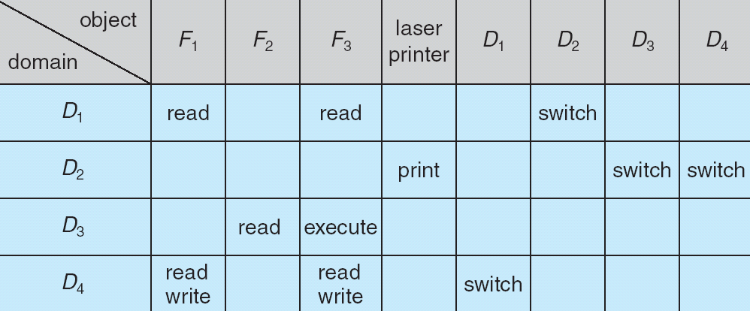
General (textbook) representation
Domains as objects added to Access Matrix
Protection and Security

Slide 21
Practicalities
At run-time…
  What does the OS know about the user?
  What does the OS know about the resources?
What is the cost of checking and enforcing?
  Access to the data
  Cost of searching for a match
Impractical to implement full Access Matrix
  Size
  Access controls disjoint from both objects and domains
Protection and Security

Slide 22
ACLs vs. Capabilities
Access Control List: Focus on resources
  Good if resources greatly outnumber users
  Can be implemented with minimal caching
  Can be attached to objects (e.g., file metadata)
  Good when the user who creates a resource has authority over it
Capability System: Focus on users
  Good if users greatly outnumber resources
  Lots of information caching is needed
  Good when a system manager has control over all resources
Protection and Security
Notes:
The issue is one of HOW we view the problem, WHERE the control information is stored, and WHEN the tests and changes are made.
Tests for rights needs to be delayed to the last minute…
Therefore, the time frame to think about is Run-Time
STEP BACK: Storage for access control information is theoretically independent of EITHER if the objects, but run-time efficiency suggests an answer...

Slide 23
Both are needed
ACLs for files and other proliferating resources
Capabilities for major system functions
The common OSs offer BOTH
  Linux emphasizes an ACL model
    provides good control over files and resources that are file-like
  Windows 2000/XP emphasize Capabilities
    provides good control over access to system functions (e.g. creating a new user, or doing a system backup…)
    Access control lists for files
Protection and Security

Slide 24
…and good management, too!
What do we need to know to set up a new user or to change their rights?
…to set up a new resource or to change the rights of its users?
…Who has the right to set/change access rights?
No OS allows you to implement all the possible policies easily.
Protection and Security

Slide 25
Enforcing Access Control
User level privileges must always be less than OS privileges!
  For example, a user should not be allowed to grab exclusive control of a critical device
  or write to OS memory space
…and the user cannot be allowed to raise his privilege level!
The OS must enforce it…and the user must not be able to bypass the controls
In most modern operating systems, the code which manages the resource enforces the policy
Protection and Security
Notes:
Why User < System?
What resources are users not allowed to manipulate?
(physical memory, physical disk, etc…)
Why not allow the user to increase privs?
How does Linux handle user privs?

Slide 26
(Traditional) Requirements–System Call Code
No user can interrupt it while it is running
No user can feed it data to make it
  violate access control policies
  stop serving other users
No user can replace or alter any system call code
No user can add functionality to the OS!
Data must NEVER be treated as code!
Protection and Security
Notes:
Get them to talk about WHY...

Slide 27
“Yeah, but …”
No user can interrupt it while it is running
    Windows, Linux routinely interrupt system calls
No user can feed it data to make it
    violate access control policies
    stop serving other users
No user can replace or alter any system call code
    Except your average virus
No user can add functionality to the OS!
    Except dynamically loaded device drivers
Data must NEVER be treated as code!
    “One man’s code is another man’s data” A. Perlis
Protection and Security
Notes:
Get them to talk about WHY...

Slide 28
Saltzer-Schroeder Guidelines
System design should be public
Default should be no access
Check current authority – no caching!
Protection mechanism should be
  Simple, uniform, built into lowest layers of system
Least privilege possible for processes
Psychologically acceptable
Protection and Security

Slide 29
Reading Assignment
Silbershatz, Chapter 14
Protection and Security

Slide 30
Questions?
CS-502 Fall 2007
Protection and Security

